Slide 1
caArray User Community Meeting
1.x Update and 2.0 Development Status
Call in: 877-416-5524
Participant Passcode: 2627056
Centra: http://ncicb.centra.com
Meeting ID: array_nov28
November 28, 2007

Slide 2
Agenda
1.6 update
2.0 Update
  Where we are
  Release status
  Demo

Slide 3
caArray 1.6 – Maintenance release
Targeted as the last release of the 1.x product, scope of 1.6 was expanded to include enhancements for data loading
  Overall memory footprint reduced
  Reduced total processing time
    Ex: Affymetrix cel file loading is ~20% faster per file
  Overall stability improved
Additional fixes described in previous meetings
  A number of issues that have been identified when loading MAGE-ML files that have been created from MAGE-TAB files using the EBI’s Tab2MAGE converter
  Annotation error for existing file in an Experiment
  Performance of adding and updating Sources
  Messaging to user for status of array design parsing
  Sample extract characteristics searches
  Addressed errors in JUnit tests upon MAGE-OM API installation
Ugrade should be straighforward
  Graphical update installer available to simplify upgrade of the portal
  For caAMEL, can download the binary distribution, drop it into JBoss, and restart

Slide 4
caArray 1.6 Release Schedule
1.6 is in the process of being deployed to Production
Code will be packaged on GForge today
NCICB Download Center will be updated within the next week

Slide 5
1.x >> 2.0 transition
The NCICB production instance of caArray 1.x will be ultimately be converted to read-only
  To avoid two instances where data could be loaded
  Conversion will likely happen after the 2.0 release
1.x will be kept up for at least 6 months – longer if needed by the community
Data from 1.x will be migrated to 2.0
  1.x Experiments URLs will be supported in 2.0 so that external references are maintained
  Experiment Annotations will be exported into MAGE-TAB and Imported into 2.0 along with data files
  For local installers of caArray who want to migrate their data, support will be provided by the caArray team

Slide 6
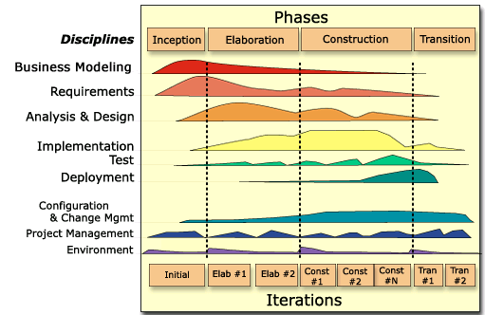
caArray 2.0 - Where We Are
2.0 Transition 1
  caArray 2.0 is “feature complete”
  Model annotation is near completion, to start registration process next week
  End user documentation is in process
  GUI Installer is being created

Slide 7
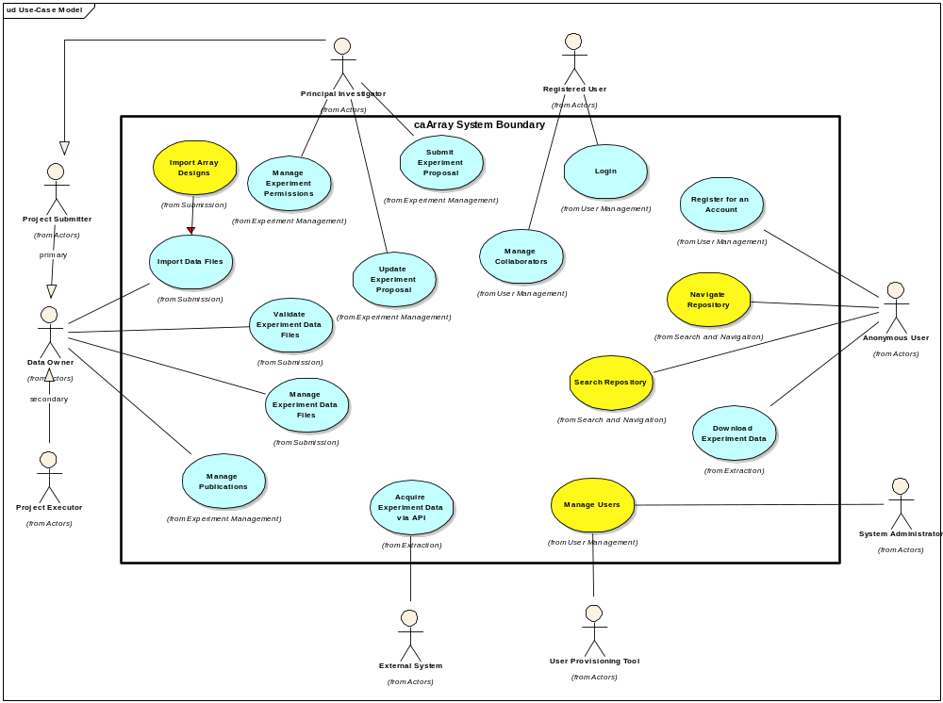
Use Cases Implemented

Slide 8
caArray 2.0 Release Status
Release is the focus of intensive QA and bug fixes
  6 dedicated testers plus more….
  36% of identified bugs fixed (44/121)
  Usability improvements, Performance against the UI and the API
We will make the call next week as to whether we will put software into Production on December 14, our targeted release date.
  Will not go to Production with any “showstopping” bugs
  Timeline would be extended accordingly in this event
caArray 2 will be part of the Life Sciences Distribution, to be released in Q1, 2008
  https://cabig.nci.nih.gov/getting_connected/working_with_cabig/

Slide 9
Live Demonstration
Walkthrough of critical use cases
  Navigate and Search Repository
  Login and Create an Experiment
    Experiment States – Draft, In Progress, Public
    Walk through of UI Experiment Concepts
  Validate Data
  Import Array Data
    Import MAGE-TAB Data
    Import Supplemental Data
  Import an Array Design
  Manage Collaborators
  Manage Permissions

Slide 10
Key documents for reference
caArray Vision Document
  https://gforge.nci.nih.gov/svnroot/caarray2/trunk/docs/requirements/caarray_vision.doc
caArray 2.0 Scope Document
  https://gforge.nci.nih.gov/svnroot/caarray2/trunk/docs/requirements/caarray_scope_2_0.doc
caArray 2.0 Use Case Specifications
  https://gforge.nci.nih.gov/svnroot/caarray2/trunk/docs/requirements/use_cases
caArray 2.0 Software Architecture Document
  https://gforge.nci.nih.gov/svnroot/caarray2/trunk/docs/analysis_and_design/caarray_software_architecture_document.doc
caArray Domain Model (IE Only)
  https://gforge.nci.nih.gov/svnroot/caarray2/trunk/docs/analysis_and_design/models/html/caarray_client_model/index.htm
caArray Installation Guide
  https://gforge.nci.nih.gov/svnroot/caarray2/trunk/docs/deployment/auto-remote-deploy/caarray2-installation-instructions.doc
Slides from past Users Meetings
  https://gforge.nci.nih.gov/svnroot/caarray2/trunk/docs/project_management/open_meetings

Slide 11
Continuing Engagement Model
Continue Monthly Meetings
Work directly with Cancer Centers for Installation Support and Feature Elicitation and Prioritization for what we should focus on next
G-Forge site for 2.0 is available that indicates needs, features, use cases, test cases and defects
G-forge site: https://gforge.nci.nih.gov/projects/caarray2/

Slide 12
Next Steps
Please visit G-Forge: https://gforge.nci.nih.gov/projects/caarray2/ to view the prioritization of features, use cases (Tracker items), links to critical documents (Docs Tab)
Next meeting date: TBA but anticipated December 19, 2007

